Slide 1
Project: Day 4
Mainul Chowdhury

Slide 2
Customer testimonial section

Slide 3
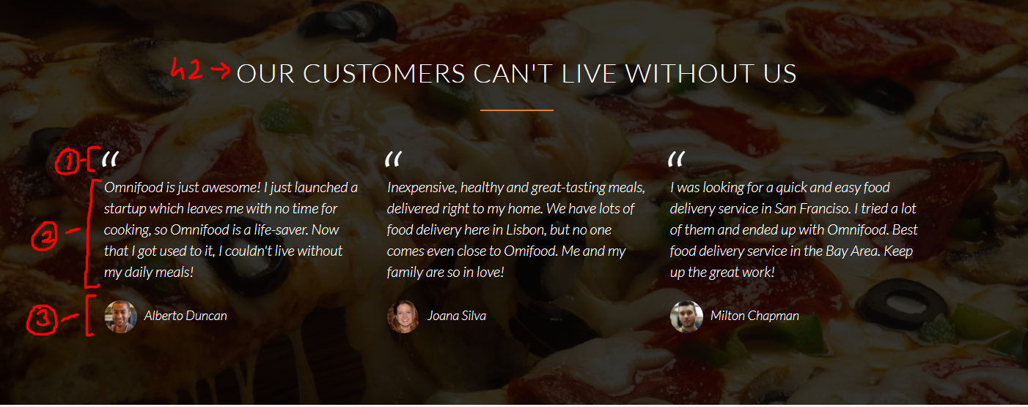
Testimonial section

Slide 4
Testimonial section
HTML elements used here -
Blockquote:before
Blockquote
Cite

Slide 5
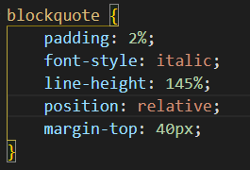
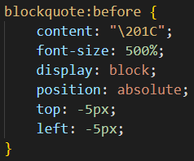
Testimonial section

Slide 6
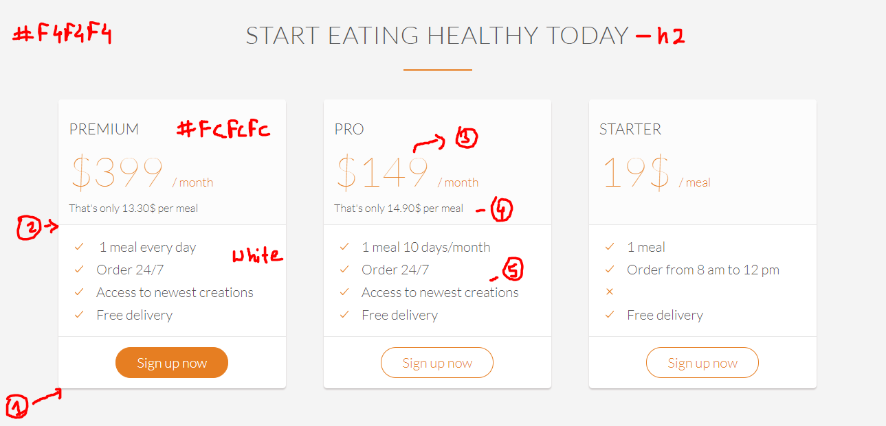
Testimonial section

Slide 7
Sign up section
In this screenshot -
box-shadow: 0 2px 2px #cac5c5;
border-bottom: 1px solid #e8e8e8;
font-size: 300%; font-weight: 100;
font-size: 30%; font-weight: 300;
font-size: 80%;
Notice how the font weight is generally higher for larger font sizes.

Slide 8
Finish designing these sections.
All the best!

